Slide 1
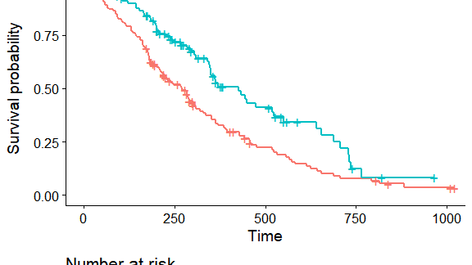
BIOSTATISTICS MINI PROJECT
Assessing the Impact of Treatment-Dependent Censoring on Survival Analysis in Clinical Trials Using Copulas
Odey R. Mofokeng
School of Actuarial Science and Statistics
University of the Witwatersrand, Johannesburg
2555438@students.wits.ac.za
2025

Slide 2
INTRODUCTION
Introduction & Research Context
Importance of Survival Analysis
Research Aim
Time-to-event data analysis is fundamental to understanding outcomes in epidemiological research, particularly in clinical trials where tracking patient outcomes over time is critical.
This project evaluates the impact of treatment-dependent censoring on survival analysis in a simulated clinical trial and assesses the effectiveness of copula-based methods in correcting biases compared to standard survival methods.
The Independent Censoring Assumption
1
Simulate clinical trial with copula-based dependent censoring
Standard methods like Kaplan-Meier (KM) and Cox proportional hazards models assume censoring is independent of event times—an assumption frequently violated in practice.
2
Quantify bias using standard methods (KM, Cox)
3
Implement copula-based corrections (CG estimator)
4
Conduct sensitivity analysis across dependence levels
Treatment-Dependent Censoring
When censoring is influenced by treatment assignment (e.g., patients dropping out due to side effects), it creates dependent censoring that introduces significant bias in survival estimates.
Key Innovation
Copula-based approaches model the joint distribution of event and censoring times, enabling more accurate survival inference without altering marginal distributions.

Slide 3
PROBLEM STATEMENT
The Problem: Dependent Censoring in Clinical Trials
What is Dependent Censoring?
Literature Foundation
Dependent censoring occurs when the censoring time C is stochastically dependent on the event time T, violating the independent censoring assumption of standard survival analysis methods.
Rivest & Wells (2001)
Introduced the copula-graphic (CG) estimator to adjust KM for dependent censoring, demonstrating reduced bias in cancer survival data.
Emura & Chen (2018)
Mathematically: Standard methods assume P(C | T) = P(C), but under dependent censoring, P(C | T) ≠ P(C)
Advanced likelihood-based copula methods, highlighting utility for treatment-related dropouts in cancer trials.
Okhrin & Ristig (2014)
Real-World Example
Consequence
Introduced Hierarchical Archimedean Copulas (HACs) to capture multi-level dependencies in survival data.
Patients in treatment arm experiencing severe side effects may drop out earlier, creating dependency between censoring and survival times.
Biased survival estimates, incorrect hazard ratios, and misleading treatment effect conclusions.
Deresa & Van Keilegom (2024)
Enhanced copula-based Cox models with covariates, proving identifiability in clinical trials.
Why Standard Methods Fail
Research Gap
KM Estimator
Cox Model
Log-Rank Test
Limited exploration of how misspecifying the dependence parameter (Kendall's τ) or copula family affects survival estimates in epidemiological trials.
Assumes independent censoring
Biased HR under dependence
Invalid under dependence

Slide 4
METHODOLOGY
Simulation Design
A two-arm clinical trial was simulated with 1,500 patients per group (3,000 total), capturing treatment-dependent censoring where dependence between event times T and censoring times C varies by arm.
Control Group (Z=0)
Treatment Group (Z=1)
Copula Model
Copula Model
Clayton Copula with α = 0.5, corresponding to Kendall's τ = 0.2 (weak positive dependence)
Nested HAC with inner Clayton (α_inner = 2, τ_inner = 0.5) and outer Clayton (α_outer = 1, τ_outer = 1/3)
Marginal Distributions
Marginal Distributions
Event times: T ~ Exp(0.1), median ≈ 6.93
Event times: T ~ Exp(0.08), median ≈ 8.66 (treatment efficacy)
Censoring times: C ~ Exp(0.1), median ≈ 6.93
Censoring times: C ~ Exp(0.1), median ≈ 6.93
Rationale: Clayton copula models positive lower tail dependence, suitable for scenarios where early events correlate with early censoring.
Rationale: HAC incorporates a latent side-effect variable, reflecting stronger dependence from treatment-related dropouts.
Simulation Parameters Summary
Group
Copula
Kendall's τ
Event Rate λ_T
Censoring Rate λ_C
Control
Clayton
0.2
0.1
0.1
Treatment
Nested HAC
0.5 (inner)
0.08
0.1

Slide 5
RESULTS
Standard Methods: Bias Detection
Cox Model Results
Kaplan-Meier Survival Estimates
Unadjusted HR
True HR
KM Estimate at t=10
True Survival at t=10
0.5913
0.8000
0.667
0.527
Bias = +0.140 (26.6% overestimation)
95% CI
0.5302 – 0.6595
p-value
< 2e-16
Control Group
KM estimate lies above true curve, gap widening over time, reaching ~0.06 difference at t=10.
Coefficient
-0.5254
Concordance
0.57
Treatment Group
KM estimate shows larger discrepancy, staying above true curve by ~0.14 at t=10 due to stronger dependence.
Key Finding: The unadjusted HR of 0.5913 is substantially lower than the true HR of 0.8, indicating a 26% downward bias due to dependent censoring removing high-risk patients in the treatment group.
Mechanism: KM's assumption of independent censoring causes consistent upward bias—censored observations are misinterpreted as survivors, more pronounced in treatment due to higher dropout rates.
Stratified Cox Model
The stratified Cox model, accounting for group differences without estimating a treatment effect, yields a null model with no HR or significance, confirming that the observed effect stems from censoring bias rather than a true treatment difference.
Critical Insight
Both KM and unadjusted Cox models are unsuitable under treatment-dependent censoring, producing systematically biased estimates that could lead to incorrect clinical decisions.

Slide 6
COPULA-BASED CORRECTION
Copula-Graphic Estimator: Bias Correction
CG Estimator Approach
CG Estimator Results
The Copula-Graphic (CG) estimator adjusts the Kaplan-Meier estimator by incorporating a specified copula to account for dependent censoring.
True S(10)
CG Estimate
KM Estimate
0.527
0.527
0.667
How It Works
Re-weights the risk set based on the copula's dependence parameter, correcting for the dependency between event and censoring times.
CG 95% CI (Treatment)
[-0.0369, 0.0398]
Tight interval indicates high precision
Optimization Strategy
Kendall's τ = 0.37 was identified as optimal through sensitivity analysis, minimizing bias and MSE at t=10.
KM 95% CI (Treatment)
[0.1112, 0.1775]
Biased away from true value
Implementation
Key Achievement: CG estimator with τ=0.37 aligns almost perfectly with true survival, demonstrating the critical importance of properly modeling dependence structure.
R package compound.Cox with bootstrap confidence intervals (R=2000) for uncertainty quantification.
Performance Metrics at t=10
CG Bias
KM Bias
0.0001
0.1434
Validation
The large sample size (n=3,000) combined with bootstrap CIs boosts reliability, giving confidence in the observed trends. Boxplot analysis shows CG biases centered near zero at τ=0.37.
99.9% bias reduction compared to KM

Slide 7
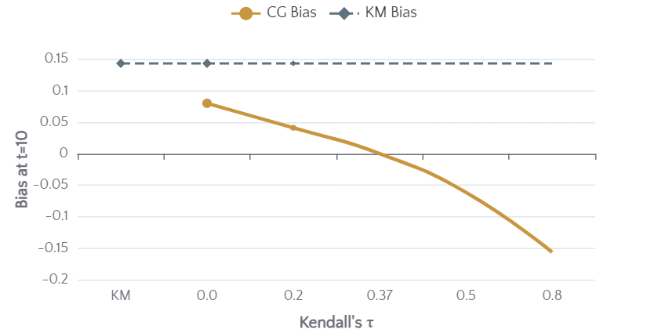
ROBUSTNESS ASSESSMENT
Sensitivity Analysis: Dependence Parameter Impact
Low Dependence (τ=0.2)
Optimal (τ=0.37)
High Dependence (τ=0.8)
S0 Bias:
-0.0031
S0 Bias:
-0.0679
S0 Bias:
-0.1672
S1 Bias:
0.0412
S1 Bias:
0.0001
S1 Bias:
-0.1565
S1 MSE:
0.0058
S1 MSE:
0.0000
S1 MSE:
0.0245
Early improvement observed
✓ Best fit - Minimal bias
Over-correction occurs
Bias vs. Kendall's τ
Key Insights
1
Optimal Range: Moderate dependence (τ ≈ 0.3-0.5) provides near-correct estimates
2
Over-correction Risk: Extreme τ values (≥0.5) lead to underestimation
3
Precision: Tight CIs at τ=0.37 due to large sample size (n=3,000)
4
Trade-off: CG switches from overestimation to underestimation as τ increases
MSE Comparison
At τ=0.37, S1 MSE = 0.0000 vs. KM MSE = 0.0205—a dramatic improvement in estimation accuracy.

Slide 8
SUMMARY
Key Findings & Implications
Primary Findings
Clinical Implications
1. Standard Methods Fail Under Dependence
Trial Design
Researchers should assess censoring mechanisms and consider copula-based methods when dropout is treatment-related.
KM overestimated survival by 0.14 at t=10; Cox HR was 26% biased downward (0.5913 vs. true 0.8).
Regulatory Submissions
Sensitivity analyses using CG estimators can strengthen regulatory evidence by addressing dependent censoring concerns.
2. CG Estimator Corrects Bias
With optimized τ=0.37, bias reduced to 0.0001—a 99.9% improvement over KM.
Patient Safety
Accurate survival estimates ensure proper evaluation of treatment benefits vs. risks, informing patient care decisions.
3. Dependence Parameter Matters
Sensitivity analysis confirms τ=0.37 as optimal; extreme values cause over-correction.
Methodological Impact
4. Large Samples Enhance Precision
This study confirms that copula-based approaches can significantly improve survival analysis accuracy in trials with treatment-dependent censoring, establishing a foundation for more reliable health research methodology.
Tight 95% CIs ([-0.0369, 0.0398]) due to n=3,000 with bootstrap validation.
99.9%
0.0001
3,000
0.37
Bias Reduction
CG Bias at t=10
Sample Size
Optimal τ

Slide 9
DISCUSSION
Limitations & Future Directions
Study Limitations
Future Research Directions
1
Fixed Exponential Marginals
1
Data-Driven τ Estimation
Simplifies the model but may not reflect real-world scenarios where hazards change over time, potentially limiting generalizability.
Develop methods to estimate τ directly from data, enabling adaptive adjustments rather than relying on fixed values.
2
Time-Dependent Hazards
2
Limited Dependence Range
Extend models to include time-dependent hazards for greater flexibility and realism in clinical scenarios.
τ range of 0–0.8 covers moderate to strong dependence but might miss extreme cases that could occur in practice.
3
Real-World Validation
Test these methods on actual clinical datasets to validate practical utility and identify implementation challenges.
3
Reliance on True τ Value
4
HAC Software Development
Focus on single optimized τ relies on simulation's true value, which may not hold in real data where dependence varies.
Develop R packages supporting HAC survival estimation with censored data to enable nested dependence modeling.
4
HAC Implementation Gap
5
Multiple Copula Families
No R packages support HAC survival estimation with censored data; custom development was beyond study scope.
Compare performance across Clayton, Gumbel, Frank, and other copula families under various dependence structures.
HAC Note
Research Impact
Hierarchical Archimedean Copulas (HACs) were planned for nested dependence modeling but excluded due to lack of software support for censored data survival estimation.
This project establishes a strong foundation for improving survival analysis under challenging censoring conditions, offering a pathway for future research to build upon these insights.

Slide 10
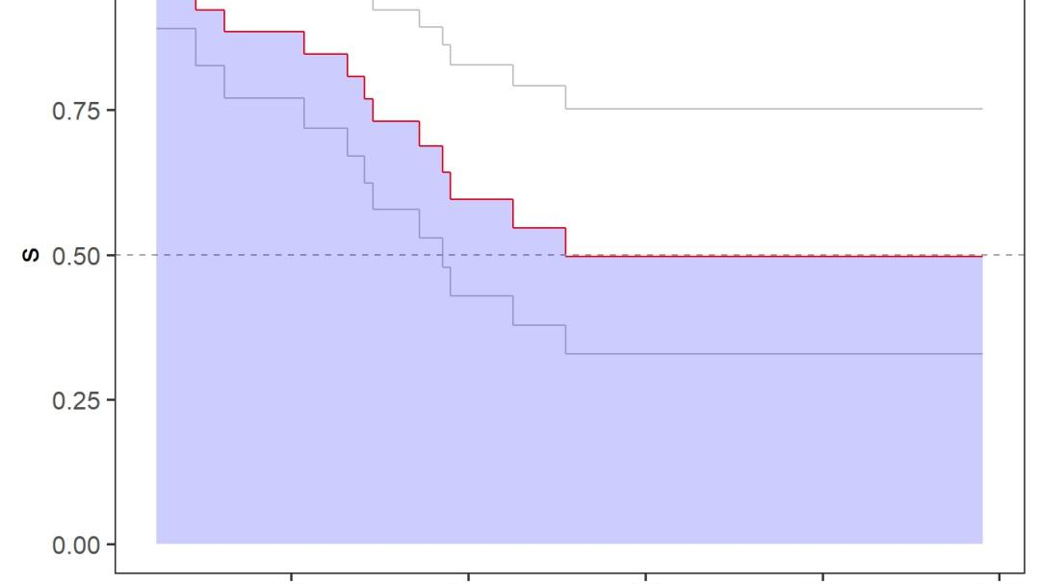
CONCLUSION
Copula-Based Methods Transform Survival Analysis Accuracy
This study demonstrates that copula-based methods, particularly the Copula-Graphic estimator with properly optimized dependence parameters, significantly improve survival analysis accuracy in clinical trials with treatment-dependent censoring.
The 99.9% bias reduction achieved—from 0.1434 (KM) to 0.0001 (CG at τ=0.37)—validates the critical importance of modeling dependence structures in survival analysis. This work establishes a foundation for more reliable health research methodology.
Accurate Estimates
Robust Inference
Research Foundation
Proper dependence modeling eliminates systematic bias
Sensitivity analysis validates method reliability
Pathway for future methodological advances
Odey R. Mofokeng | School of Actuarial Science and Statistics | University of the Witwatersrand
2555438@students.wits.ac.za | 2025

